Slide 1
SECURE DATA HIDING IN IMAGE USING STEGANOGRAPHY
Presented By
Student Name : Chandreyee Chattopadhyay
College Name & Department : Heritage Institute of Technology, Computer Science and Engineering

Slide 2
OUTLINE
Problem Statement
Technology used
Wow factor
End users
Result
Conclusion
Git-hub Link
Future scope

Slide 3
Problem Statement
Develop a reliable encryption and decryption mechanism for securely storing and transmitting sensitive data. This project ensures secure data embedding within images to protect information from unauthorized access. It utilizes pixel manipulation techniques to encode messages within an image, ensuring that the original image remains visually unchanged while securely holding the hidden data.

Slide 4
Technology used
1. Programming Language: - Python
2. Libraries & Frameworks:- OpenCV(cv2) and os
3. System Requirements:
Processor: Intel Core i3
RAM: 8GB
Storage: 100 GB
Graphics: Integrated GPU sufficient for basic image processing.
4. Operating System – Windows 11
Integrated Development Environment (IDE): Visual Studio Code

Slide 5
Wow factors
Image-Based Steganography: Hides messages within images, making them undetectable.
Passcode-Protected Decryption: Ensures only authorized users can access the hidden data.
Lightweight & Fast Processing: Efficient encryption and decryption using OpenCV.
Self-Contained Encryption: No extra files needed; the image itself stores the secret message
Cross-Platform Compatibility: Works seamlessly on Windows, Linux, and macOS without
specialized hardware.

Slide 6
End users
Multinational Companies (MNCs)
Government & Defense Organizations
Cybersecurity & Digital Forensics Experts
Banking & Financial Institutions
Academic & Research Institutions
Individuals looking for secure message transmission

Slide 7
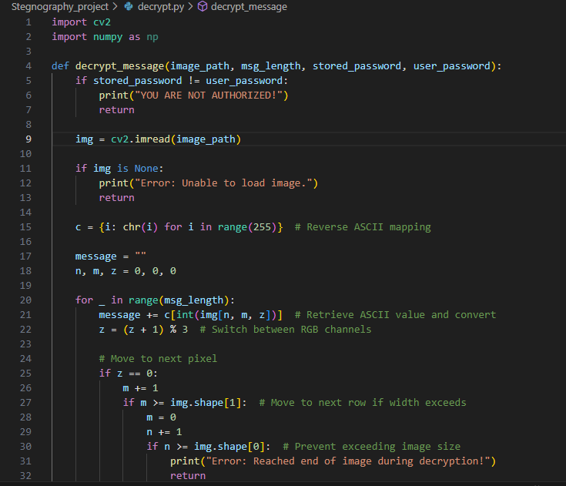
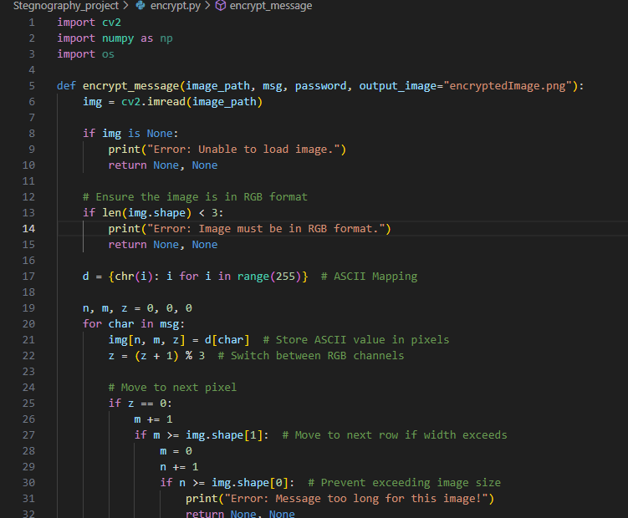
Results

Slide 8
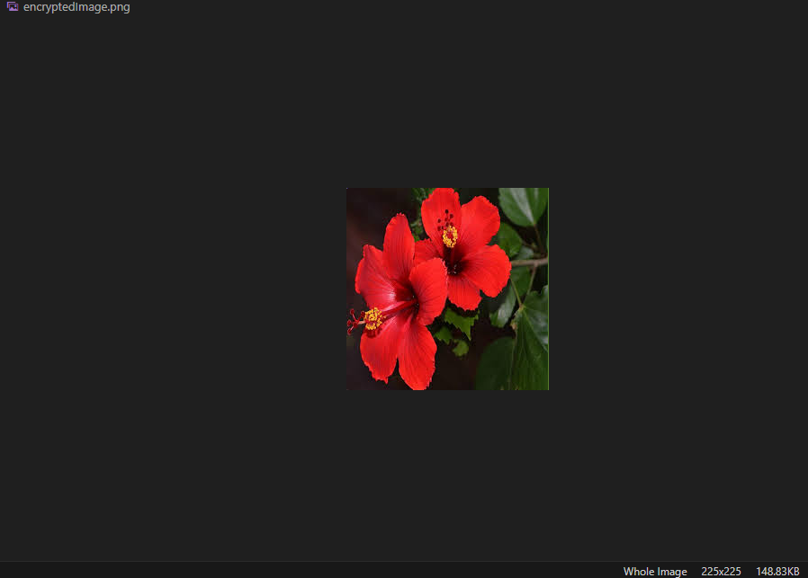
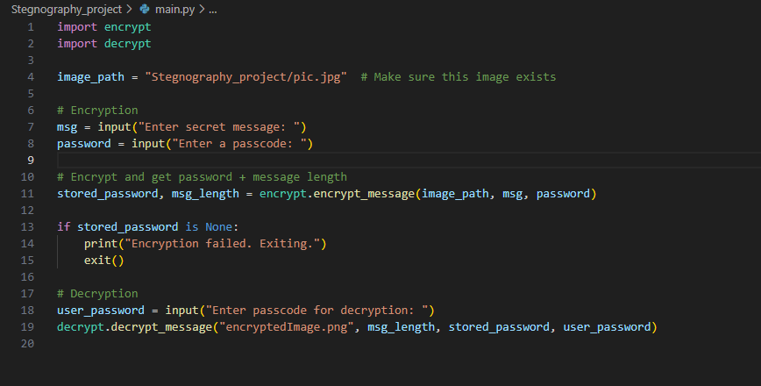
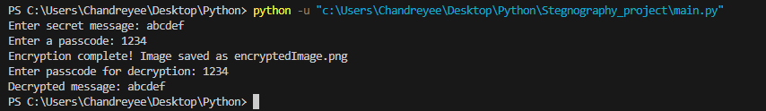
RESULTS

Slide 9
Conclusion
This project ensures secure data handling by embedding encrypted messages within images. It uses pixel manipulation and passcode protection to prevent unauthorized access. The encryption process maintains image quality while securely storing sensitive information. Lightweight and cross-platform, it offers an efficient approach to secure communication. Future improvements can include advanced encryption and cloud-based security.

Slide 10
GitHub Link
https://github.com/Chandreyee-Chattopadhyay/Steganography_project.git

Slide 11
Integration with Advanced Encryption Algorithms: Implement AES or RSA for enhanced security.
Support for Multiple Image Formats: Extend compatibility to JPEG, BMP, and GIF.
Cloud-Based Secure Storage: Enable encrypted image storage and retrieval over cloud services.
Stealth Mode Encryption: Hide encrypted images within normal images to avoid detection.
Mobile App Development: Implement the system for Android and iOS for secure communication.
Future scope(optional)

Slide 12
THANK YOU

